Slide 1
MANUFACTURING OF P.P. BAGS
SUNIDHI INDUSTRIES

Slide 2
agenda
INTRODUCTION
USAGE
PROCESS OF MAKING BAGS

Slide 3

INTRODUCTION:-
A very important characteristic of any PP woven bags aka Polypropylene woven bags is that it is RecyclableWE can manufacture customized bags with a vast variety of styles and prints, different types of closures, laminated/un-laminated, different weave/denier and even printing up to 8 colors.

Slide 4
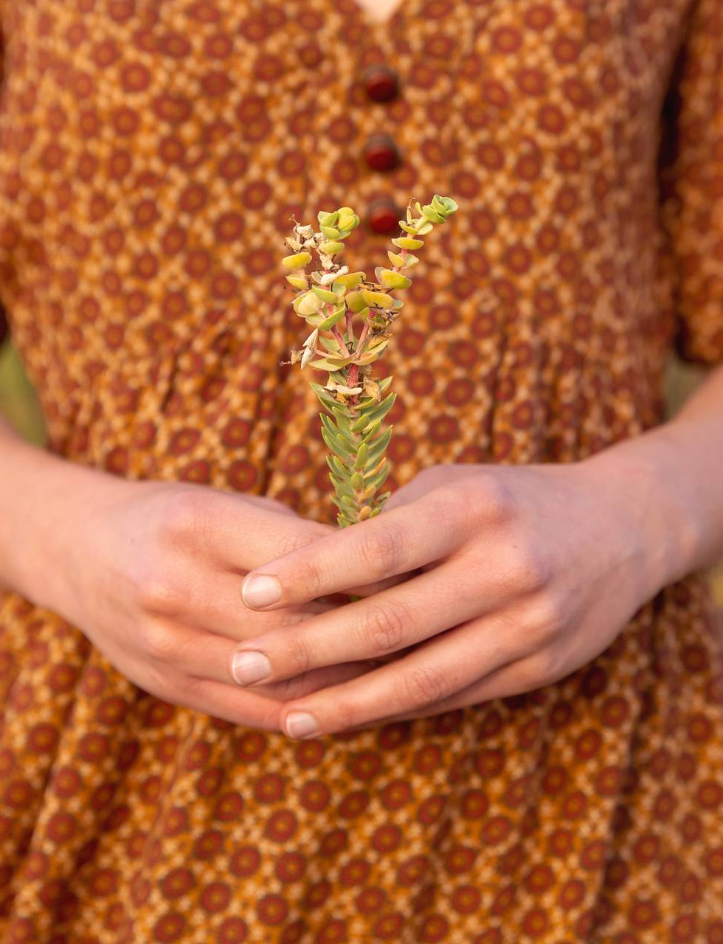
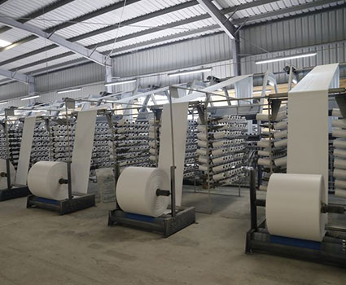
USAGE OF P.P. BAGS:-
Salt Bags
Flour Bags
Fertilizer BagS
Rice Bags
Sand BagS
Firewood Bags
Coal Bags
.
Cement Bags
.
Chemical Bags

Slide 5
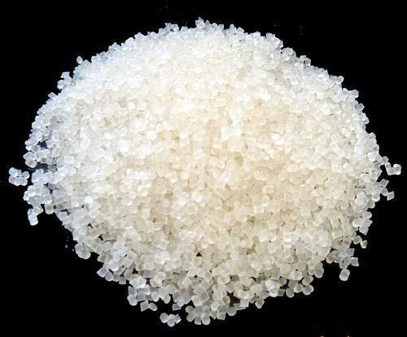
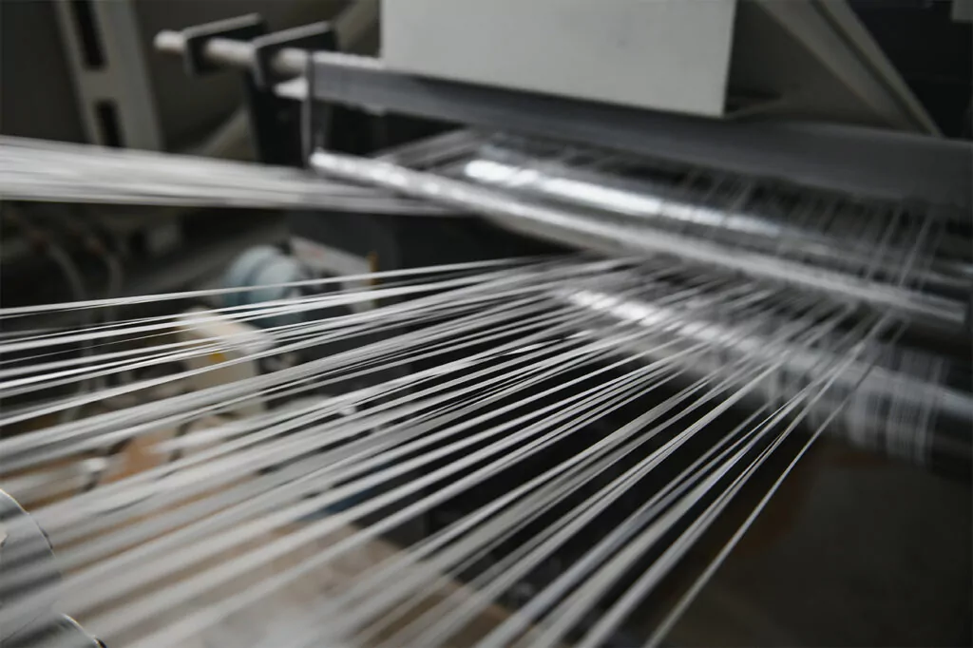
PROCESS OF MAKING BAGS
1. PP woven bags raw material
The first step in the PP woven sacks manufacturing process is ensuring we source only the highest-quality polypropylene (PP) resin, which is well-known for its strength and durability.
With this in mind, the following additives may be used:
UV stabilizers: UV stabilizers are added to reduce the impact of exposure to sunlight during transportation, storage, or outdoor use, which can cause the bags to degrade and become brittle.
Antioxidants: Antioxidants prevent the degradation of the polypropylene resin due to exposure to heat, oxygen, and other environmental factors.
Slip agents: These reduce the friction of the woven polypropylene bags, making them smoother and easier to handle during production, transportation, and storage. Ultimately, it stops the bags sticking together and allows for easy stacking and handling.
Anti-block agents: In addition to slip agents, anti-block agents also prevent any sticking together but especially in high humidity conditions, improving bag separation and handling.
Colorants provide color and appearance via the use of pigments
2. Melting the PP resin
We feed the PP resin pellets into an extruder, which is a machine that heats the resin to its melting point and then forces it through a die to form long, continuous flat tapes.
During the extrusion, the PP resin pellets are typically heated to a temperature that is above the melting point of PP, usually around 180-220°C (356-428°F). The exact temperature used may depend on factors such as the type of PP resin being used, the extrusion equipment, the desired properties of the final product, and the production speed
3. Forming & weaving the fabric
After the PP resin is melted in the extruder, it is forced through a die to form long, continuous flat tapes, which are then woven together. The temperature may be further controlled during the weaving process, depending on the specific loom and settings being used.
A weaving machine is then used to interlace the fabric in a criss-cross pattern. This is done by passing the tapes through a series of looms that interlace them, forming a tight, weave pattern.
This is achieved via the following process:
Warping: A PP tape or flat yarn is wound onto a warp beam to create the warp, which is the set of parallel yarns that runs the length of the fabric.
Shedding: The warp is then passed through a shedding device, which creates an opening or “shed” between the warp’s upper and lower layers. This allows the weft yarns to be inserted.
Weft yarn insertion: Weft yarns or tapes are inserted through the shed using shuttles or circular looms. They’re inserted perpendicular to the warp yarns, passing through the shed and interlacing with the warp yarns to create the woven polypropylene pattern.
Beating-up: A comb-like device called—the “reed”—then pushes the weft yarns tightly together. This “beating-up” process helps to create a tightly woven fabric.

Slide 6
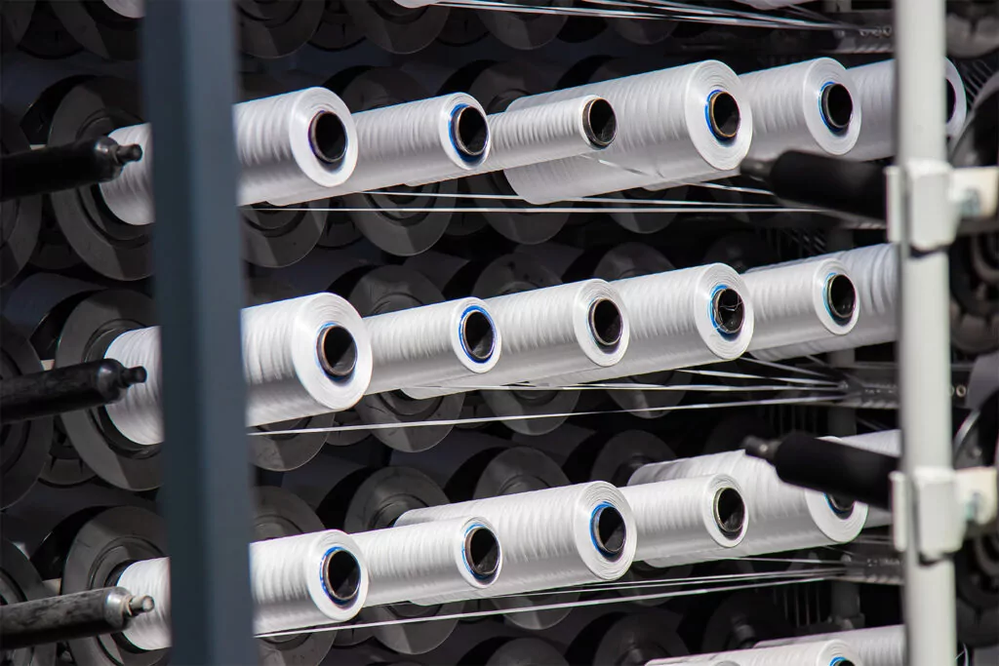
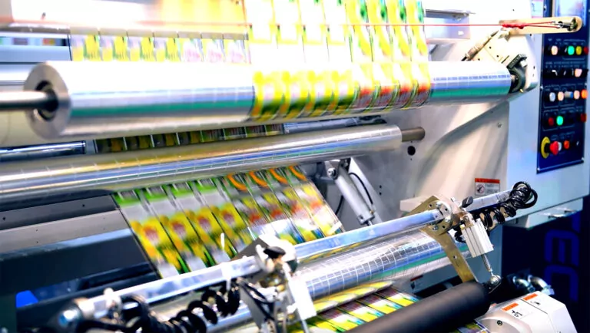
A weaving machine is then used to interlace the fabric in a criss-cross pattern. This is done by passing the tapes through a series of looms that interlace them, forming a tight, weave pattern.
This is achieved via the following process:
Warping: A PP tape or flat yarn is wound onto a warp beam to create the warp, which is the set of parallel yarns that runs the length of the fabric.
Shedding: The warp is then passed through a shedding device, which creates an opening or “shed” between the warp’s upper and lower layers. This allows the weft yarns to be inserted.
Weft yarn insertion: Weft yarns or tapes are inserted through the shed using shuttles or circular looms. They’re inserted perpendicular to the warp yarns, passing through the shed and interlacing with the warp yarns to create the woven polypropylene pattern.
Beating-up: A comb-like device called—the “reed”—then pushes the weft yarns tightly together. This “beating-up” process helps to create a tightly woven fabric.
Repeat: Steps 2 to 4 are repeated to create the desiredesired fabric width and length.
4. Treatment, coating & printing
Once the PP woven fabric is produced, it can be further treated or coated to enhance its properties.
This is where we apply a layer of BOPP (biaxially oriented polypropylene) lamination film on one or both sides of the fabric. It’s a thin, transparent, and high-strength material that can be printed on, allowing for branding and customization.
A typical process is as follows:
Pre-press preparation: Specialized graphic design software is used to create text, images, and logos that will be printed on the PP woven bags. Once the design is finalized, it’s converted into a format that can be used for printing, such as a digital file or a plate.
Plate creation: If traditional flexographic or gravure printing is used, plates need to be created. These plates are typically made of metal or other materials and are engraved or etched with the design. The plates are then mounted onto the printing press.
Ink prep: Ink is mixed according to the required color and viscosity specifications.
Printing: We then feed the woven bags into the press, where the ink is transferred onto the bags using the plates or other cylinders. This is repeated until all the different colors or layers of ink are applied.
Dry-cure: The ink is cured or dried after each application, depending on the method used.
Post-press finishing: After printing we use heat-setting to cure the ink and improve its durability and apply a varnish or coating for added protection or glossiness.
5. Cutting
Cutting the material can be done by either hot or cold cutting:
Heat Cutting
Heat cutting melts and seals the PP woven fabric edges to create clean and sealed cuts. The general heat-cutting process for PP woven bulk bags is:

Slide 7
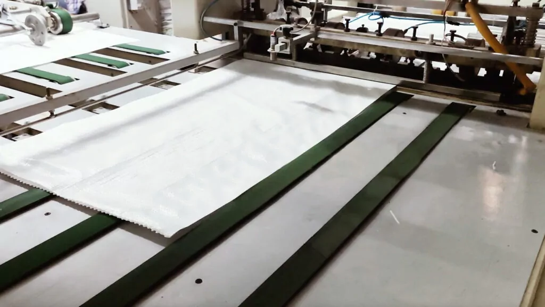
Preparation: The woven fabric is first laid out in multiple layers, and the bag panels are aligned according to the desired bag size and shape. The layers are stacked and held together securely to prevent movement during cutting.
Tool setup: A heat cutting tool, such as a hot knife or a heated wire, is set up and adjusted for the desired temperature and cutting depth. The temperature is controlled to ensure precise cutting without causing excessive melting or scorching of the fabric.
Cutting: The heat melts and seals the fabric as it cuts through, creating clean and sealed edges. The cutting tool is guided along the fabric edges, following the desired cutting line, to create the bag shape. Care is taken to ensure uniform cutting and proper sealing of the edges to prevent fraying or unraveling.
Cooling and setting: After cutting, the heated fabric edges are left to cool and set. This solidifies the melted edges and ensures that they are properly sealed and bonded. The cooling time varies due to the fabric thickness and cutting temperature.
Quality control: We ensure that the cuts are accurate, clean, and free from defects. This involves checking for proper cutting depth, sealing quality, and bag integrity.
6.Finishing: Finally, excess threads are trimmed.
Cold Cutting
The preparation, finishing and QC elements of cold cutting is the same as with heat cutting.
The biggest difference between the two processes is the elimination of heat during cutting. Instead, a knife or blade is used to mechanically cut through the fabric without applying heat.
One of the benefits of cold cutting over using heat is the reduced energy consumption for the manufacturer. However, this can only be applied to material that has been coated.
Cold cutting also reduces the risk of fraying, which can compromise the bag’s strength and durability. Even so, this doesn’t mean that heat cutting causes a weakness, since we ensure all our bags maintain the same integrity levels.

Slide 8
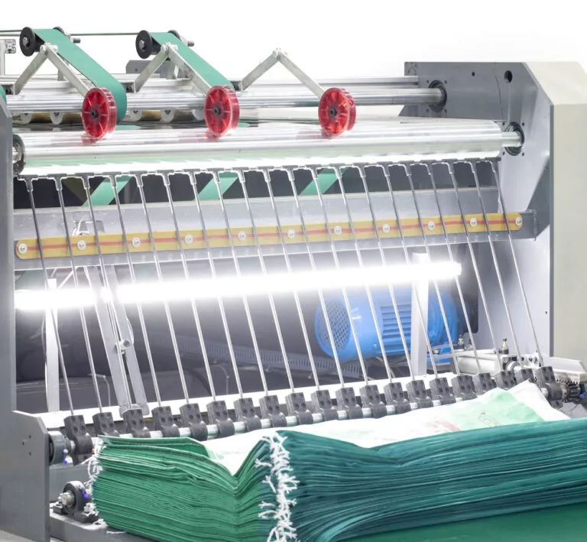
6. Sewing
The sewing process can differ greatly depending on the bag construction style (e.g., u-panel, 4-panel or circular), bottom and top design, as well as what loops are desired.
However, a typical process for sewing the bags is:
Folding: The fabric is folded along the edges that will form the sides and bottom of the bag, aligning them evenly and securing them in place with clips or pins.
Stitching the sides: Sewing begins at the top of the bag and down the sides, backstitching at the beginning and end of the seam for added strength.
Stitching the bottom: Once the sides are stitched, sewing is done across the bottom, reinforcing the seam by sewing over it multiple times or using a double stitch for added durability.
Handles or flaps: If the bag requires handles or flaps, they’re now sewn according to the desired design and specifications, ensuring they are securely attached.
Finishing: Any excess threads are trimmed and the bag is QC’d for any loose stitches or flaws, making any necessary adjustments or repairs.
7. Inspection
Even though we’re consistently inspecting a bag throughout its construction journey, a final inspection is always worthwhile to ensure we deliver the very best quality products to our customers.
This includes checking for proper stitching, reinforced stress points, proper alignment of handles or flaps, absence of defects or damage, and overall appearance.
8. Packaging
Once the bags pass the inspection, they’re packed in our secure and controlled environment. This involves stacking the bags, bundling them together, or packing them in boxes, bales, or pallets, depending on the customer’s needs.
Proper packaging is important to protect the bags from damage during transportation and storage and to ensure they are ready for distribution or sale.

Slide 9
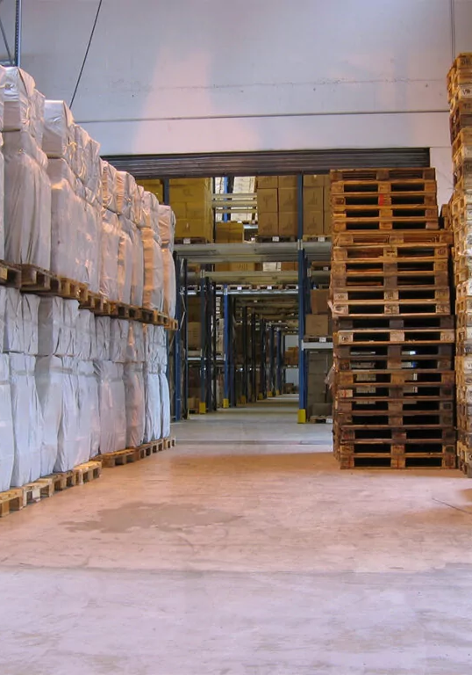
9. Labeling
Depending on the specific requirements or regulations, the bags are labeled with relevant information, such as product details, brand name, size, weight, safety instructions, and other necessary information for identification and traceability.
10. Storage
We then store your bags in our environmentally controlled, safe and secure facilities until they’re ready for shipment or distribution.

Slide 10
final tips & takeaways
Seek feedback
Reflect on performance
Explore new techniques
Set personal goals
Iterate and adapt

Slide 11
thank you

